Slide 1
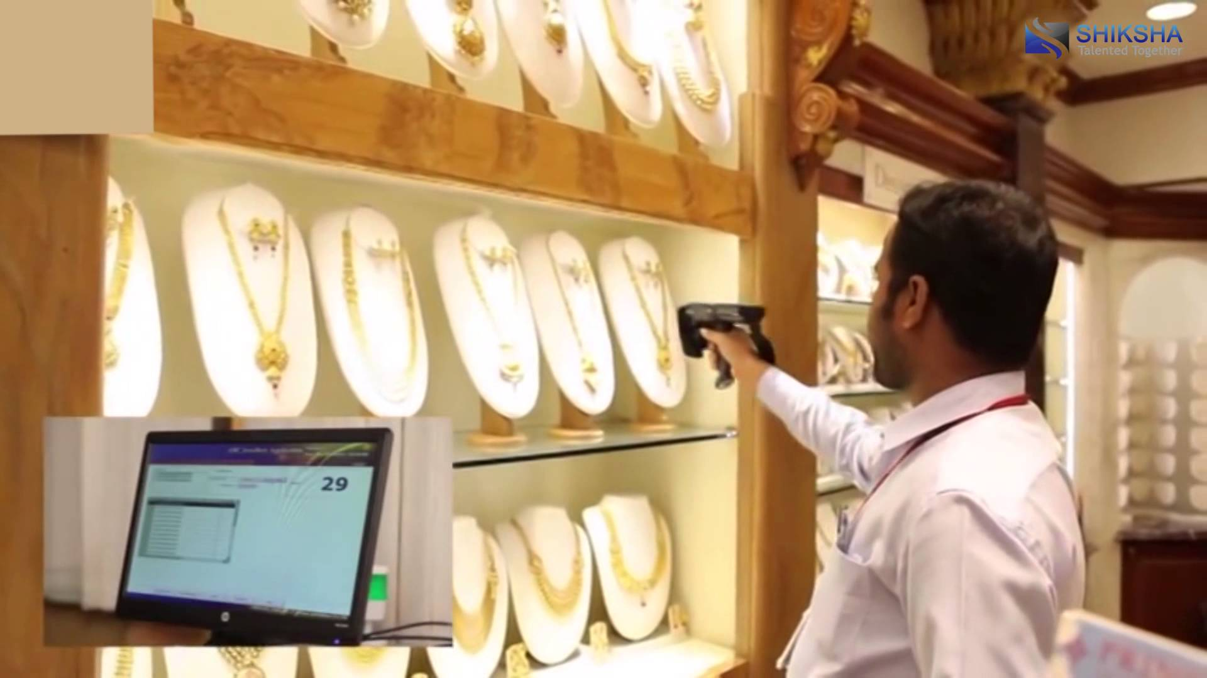
RFID Based Jewelry Tracking System
JewelryTrak

Slide 2
The Concern
A jewelry shop face a tremendous task of maintaining and accounting of thousands of jewelry item in a single store.

Slide 3
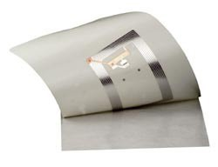
The Saviour
We need a technology that:
- Jewelers always want their premises
safe and secure from theft and unwanted practices
- Reduces manual handling time
- Improve inventory process
- Provide security to the jewelry
We need
RFID (Radio Frequency Identification)

Slide 4
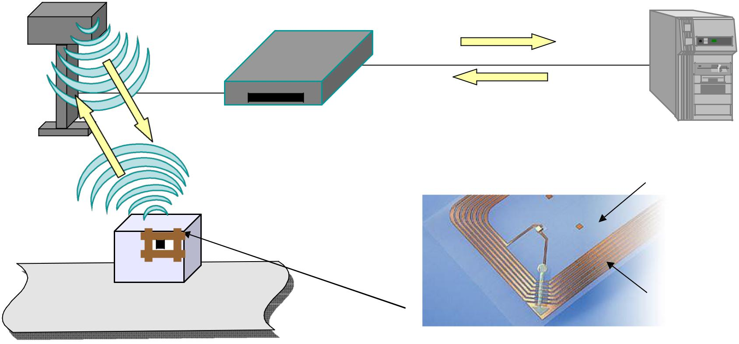
How RFID Works?
Reader broadcasts
signal through antenna
Reader sends data/info to
computer for processing
Host
Computer
Antenna reads the data and sends to reader
Antenna
Reader
The Charged tag sends identifying
response back to the reader
Polyethylene Media
_{Tag}
Tag receives signal
and gets charged
Chip
Copper coil antenna

Slide 5
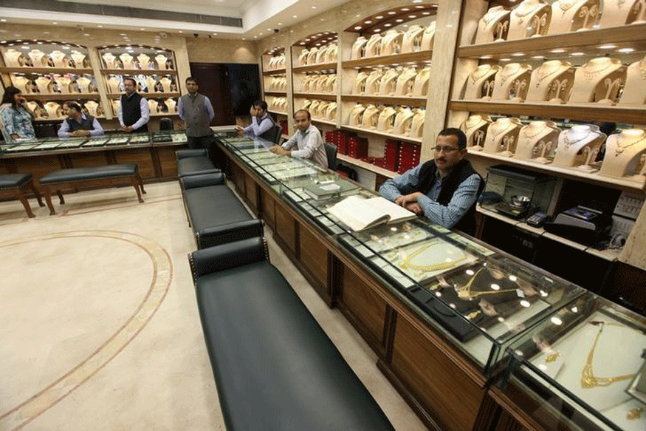
Our Solution
Considering all the pain areas of the jewelry industry, Daphne Systems offer the below solution to increase the productivity.
Jewelry Tracking System
Inventory Management System

Slide 6
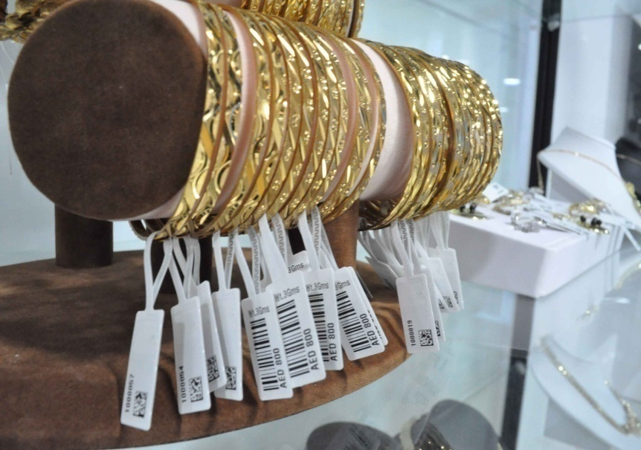
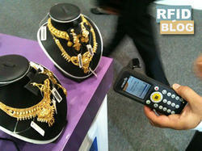
Description at a glance
Jewelry Tracking System offer you the complete tracking of your jewelry within your premises with the help of RFID technology.
All the jewelry get tagged with the RFID labels.
Now if anybody tries to carry these tagged jewelry outside, it will automatically get read by the RFID reader-antennas deployed at the entry-exit gate points and an alarm get generated.

Slide 7
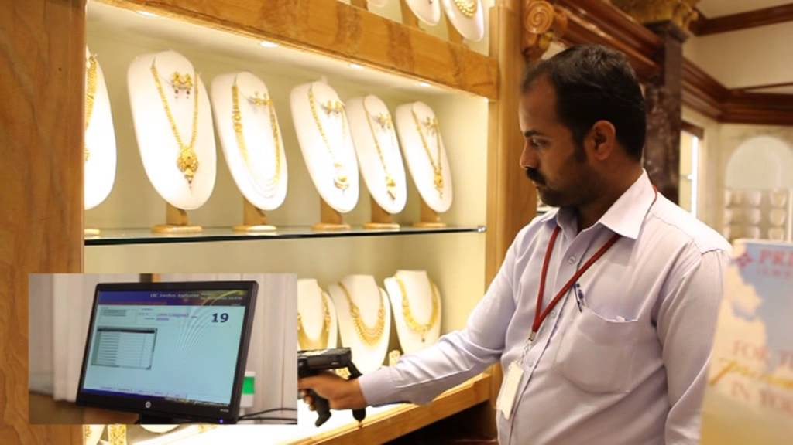
Description at a Glance
Inventory Management System:
Using a RFID handheld reader to scan each piece insure data integrity and accuracy.
RFID handheld reader are extremely accurate and will never scan any ID incorrectly, thus reducing mistake and save the time in comparison to the manual inventory management done by the staff in the end of the day.

Slide 8
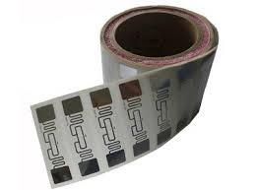
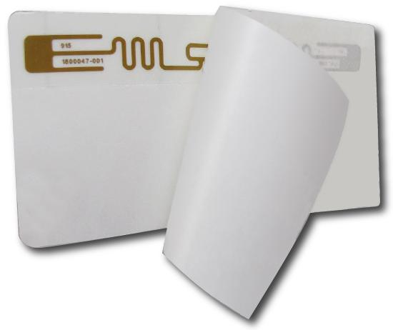
System Components
RFID Tags:
Paper thin label.
Placed inside the cover of each file/document.
Consists of an etched antenna and a tiny chip which stores vital item information.
Including a unique ID number.
Provides identification and security in a single tag.
Password protected anti-theft security bit.
Specification:
Surface material: paper or PET
IC: NXP
Frequency: 860-960MHz
Protocol-ISO 18000 6C EPC Class 1 Gen 2
Operation: -40⁰ C to 85⁰ C

Slide 9
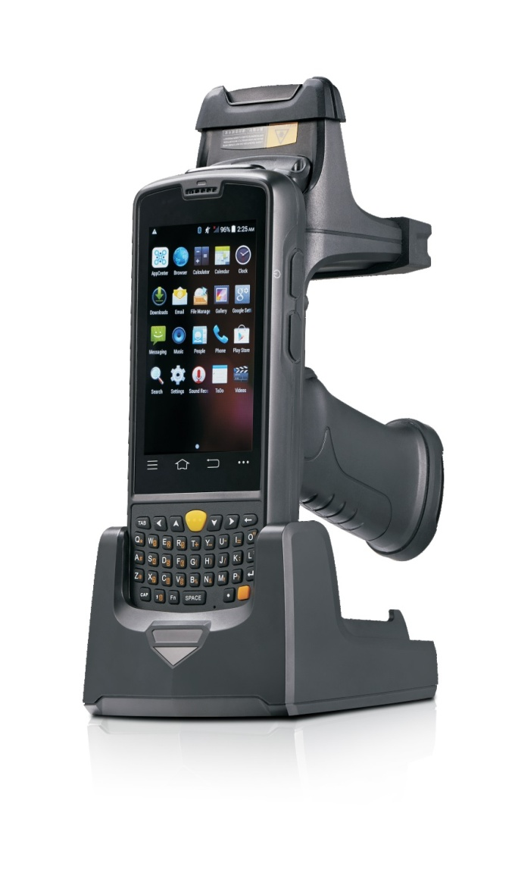
System Components
RFID Handheld Reader:
The Handheld RFID reader gives ability to capture a comprehensive range of data from RFID tags to images.
With this flexible multi-function handheld RFID reader, which reads data in remote areas where fixed RFID readers can’t reach.
Specification:
Read Range: 0.2ft to 8 ft.
Antenna: Integrated, linearly polarized
Frequency: 860-960MHz
Protocol-ISO 18000 6C EPC Class 1 Gen 2

Slide 10
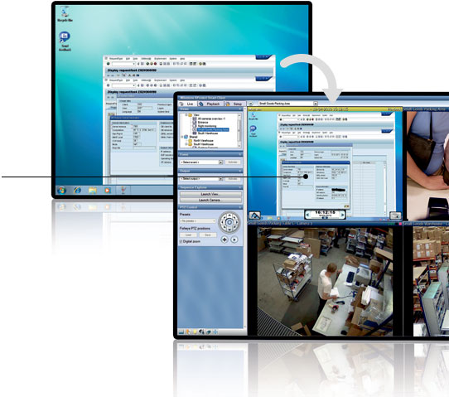
System Components
Application Software:
The JewelryTrak application software forms the backbone of the whole system.
It performs end to end functionality from programming the RFID tags and employee smart cards to query the system for locating the position of a particular jewelry.

Slide 11
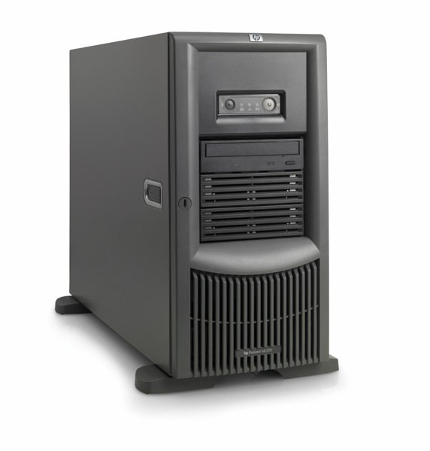
System Components
RFID Server:
Central Control Unit for all the RFID Stations in the local network.
Primary database server
Acts as a backup server in case of connection failure
Web based Admin Console
Monitor and configure RFID workstations, view customized reports etc.
Define Access Control Levels to the users.

Slide 12
Benefits
There is a strong ROI you can pull from RFID Jewelry Tracking, especially when you consider the amount of valuables professionals looking for things.
The JewelryTrak RFID System:
Eliminates searches for jewelry
Performs jewelry room or desk audit quickly
Fresh staff time for high value work
Improves productivity and reduces costs
Passively track jewelry as staff walk around
Help find particular jewelry very quickly

Slide 13
Daphne Systems Private Limited
THANK YOU
Daphne Systems Private Limited
114, First Floor, Alaknanda Commercial Complex
LSC Plot No. 3 Vikas Kendra, E-Block Vikaspuri
Delhi – 110018, Mobile No. 91+ 9910315436
Tel: 011-43021682 Email: info@daphnesystems.com

